Slide 1
Introduction to Embedded Systems Design

Slide 2
Introduction
What is an Embedded System?
Application-specific computer system
Built into a larger system
Why add a computer to the larger system?
Better performance
More functions and features
Lower cost
More dependability
Economics
Microcontrollers (used for embedded computers) are high-volume, so recurring cost is low
Nonrecurring cost dominated by software development
Networks
Often embedded system will use multiple processors communicating across a network to lower parts and assembly costs and improve reliability

Slide 3
Options for Building Embedded Systems
Implementation | Design Cost | Unit Cost | Upgrades & Bug Fixes | Size | Weight | Power | System Speed
Discrete Logic | low | mid | hard | large | high | ? | very fast
ASIC | high ($500K/ mask set) | very low | hard | tiny - 1 die | very low | low | extremely fast
Programmable logic – FPGA, PLD | low | mid | easy | small | low | medium to high | very fast
Microprocessor + memory + peripherals | low to mid | mid | easy | small to med. | low to moderate | medium | moderate
Microcontroller (int. memory & peripherals) | low | mid to low | easy | small | low | medium | slow to moderate
Dedicated Hardware
Software Running on Generic Hardware

Slide 4
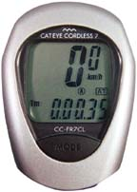
Example Embedded System: Bike Computer
Functions
Speed and distance measurement
Constraints
Size
Cost
Power and Energy
Weight
Inputs
Wheel rotation indicator
Mode key
Output
Liquid Crystal Display
Low performance MCU
8-bit, 10 MIPS

Slide 5
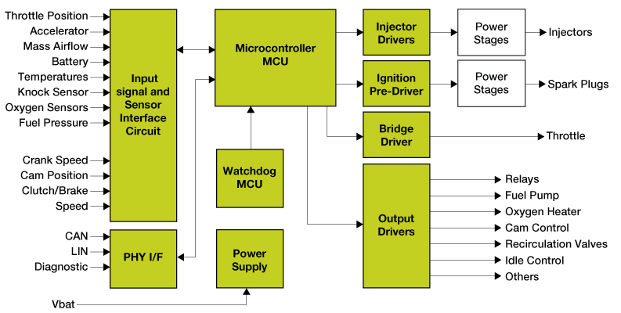
Gasoline Automobile Engine Control Unit
Functions
Fuel injection
Air intake setting
Spark timing
Exhaust gas circulation
Electronic throttle control
Knock control
Constraints
Reliability in harsh environment
Cost
Weight
Many Inputs and Outputs
Discrete sensors & actuators
Network interface to rest of car
High Performance MCU
32-bit, 3 MB flash memory, 150 - 300 MHz
Image courtesy of Freescale

Slide 6
Benefits of Embedded Computer Systems
Greater performance and efficiency
Software makes it possible to provide sophisticated control
Lower costs
Less expensive components can be used
Manufacturing costs reduced
Operating costs reduced
Maintenance costs reduced
More features
Many not possible or practical with other approaches
Better dependability
Adaptive system which can compensate for failures
Better diagnostics to improve repair time

Slide 7
Embedded System Functions
Closed-loop control system
Monitor a process, adjust an output to maintain desired set point (temperature, speed, direction, etc.)
Sequencing
Step through different stages based on environment and system
Signal processing
Remove noise, select desired signal features
Communications and networking
Exchange information reliably and quickly

Slide 8
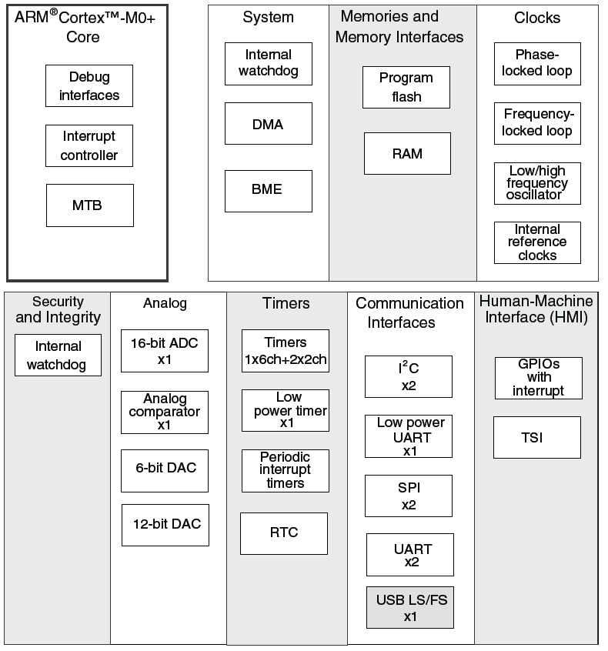
Microcontroller vs. Microprocessor
Both have a CPU core to execute instructions
Microcontroller has peripherals for concurrent embedded interfacing and control
Analog
Non-logic level signals
Timing
Clock generators
Communications
point to point
network
Reliability and safety

Slide 9
Attributes of Embedded Systems
Interfacing with larger system and environment
Analog signals for reading sensors
Typically use a voltage to represent a physical value
Power electronics for driving motors, solenoids
Digital interfaces for communicating with other digital devices
Simple - switches
Complex - displays

Slide 10
Attributes of Embedded Systems
Concurrent, reactive behaviors
Must respond to sequences and combinations of events
Real-time systems have deadlines on responses
Typically must perform multiple separate activities concurrently

Slide 11
Attributes of Embedded Systems
Fault handling
Many systems must operate independently for long periods of time, requiring system to handle likely faults without crashing
Often fault-handling code is larger and more complex than the normal-case code
Diagnostics
Help service personnel determine problem quickly

Slide 12
MCU Hardware & Software for Concurrency
CPU executes instructions from one or more thread of execution
Specialized hardware peripherals add dedicated concurrent processing
DMA - transferring data between memory and peripherals
Watchdog timer
Analog interfacing
Timers
Communications with other devices
Detecting external signal events
Peripherals use interrupts to notify CPU of events

Slide 13
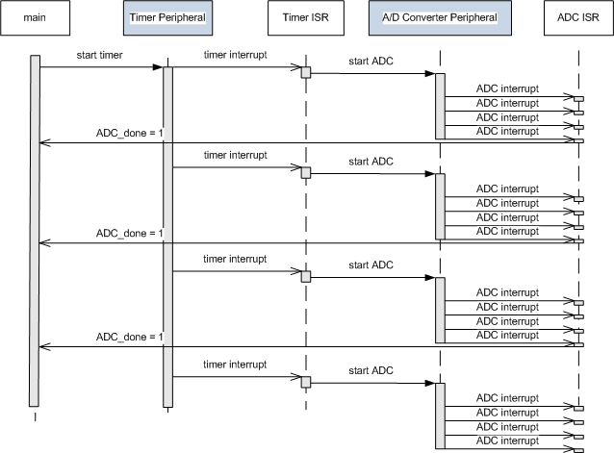
Concurrent Hardware & Software Operation
Software
Hardware
Software
Hardware
Software
Time
Embedded systems rely on both MCU hardware peripherals and software to get everything done on time

Slide 14
Constraints
Cost
Competitive markets penalize products which don’t deliver adequate value for the cost
Size and weight limits
Mobile (aviation, automotive) and portable (e.g. handheld) systems
Power and energy limits
Battery capacity
Cooling limits
Environment
Temperatures may range from -40°C to 125°C, or even more

Slide 15
Impact of Constraints
Microcontrollers used (rather than microprocessors)
Include peripherals to interface with other devices, respond efficiently
On-chip RAM, ROM reduce circuit board complexity and cost
Programming language
Programmed in C rather than Java (smaller and faster code, so less expensive MCU)
Some performance-critical code may be in assembly language
Operating system
Typically no OS, but instead simple scheduler (or even just interrupts + main code (foreground/background system)
If OS is used, likely to be a lean RTOS

Slide 16
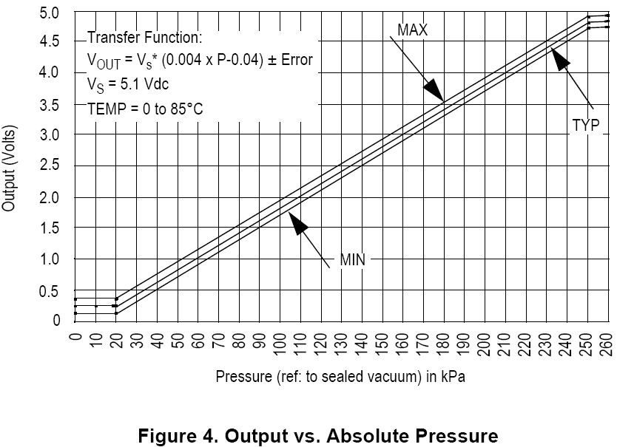
Example Analog Sensor - Depth Gauge
V_ref
// Your software
ADC_Code = ADC0->R[0];
V_sensor = ADC_code*V_ref/1023;
Pressure_kPa = 10.0 + 50*V_sensor +error;
Depth = 102.0 * (Pressure_kPa – 101.3);
Pressure Sensor
Analog to Digital Converter
Pressure
Voltages
ADC Output Codes
V_sensor
ADC_Code
V_ref
111..111
111..110
111..101
111..100
V_sensor
ADC_Code
Ground
000..001
000..000
Sensor detects pressure and generates a proportional output voltage V_sensor
ADC generates a proportional digital integer (code) based on V_sensor and V_ref
Code can convert that integer to a something more useful
first a float representing the voltage,
then another float representing pressure,
finally another float representing depth

